Slide 1
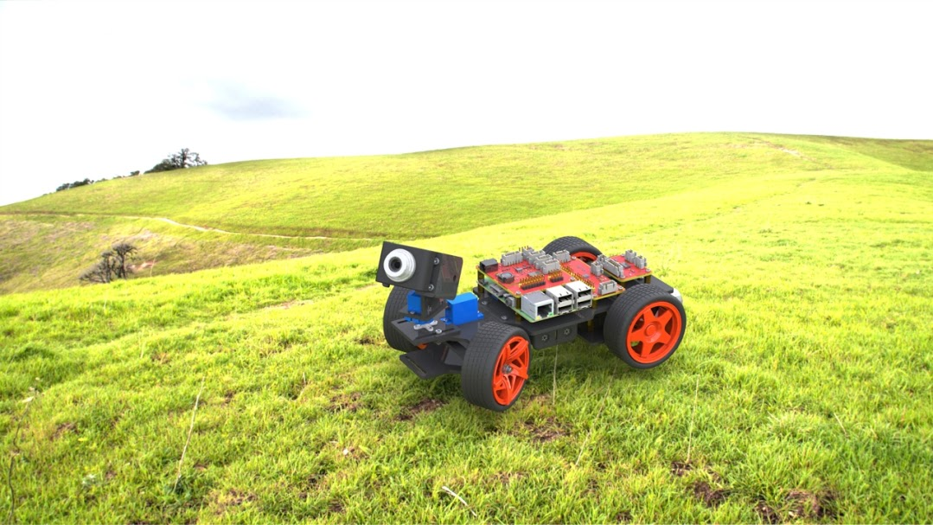
מעבדה בגרפיקה ממוחשבת 20 4704 א01
Pi Car Trajectory
By: Michael Aga
ID: 039214820

Slide 2

Project Goals
Run DDP / Newton Trajectory Algorithms and transmit to an Raspberry based RC car (online/offline methods)

Slide 3
Project Dev Plan
Find suitable Hardware for the project.
Select dev. Environment and technology (OS, toolchains, programming language etc.)
Learn Alg & Extract trajectory information from MATLAB and send to RC car
Calibrate car parameters to fit trajectory calculations

Slide 4
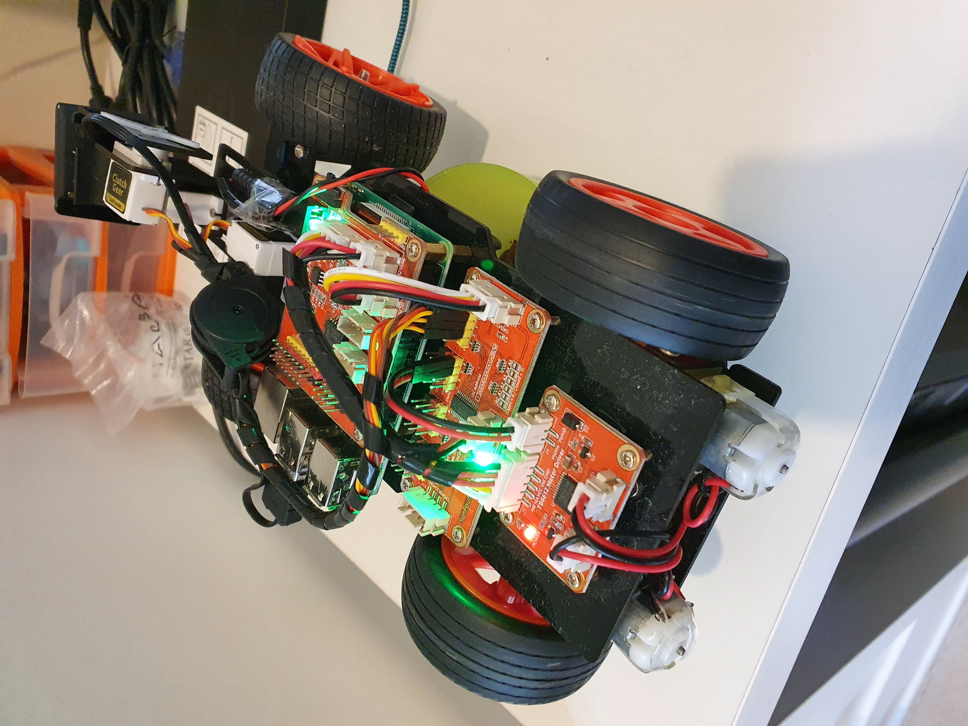
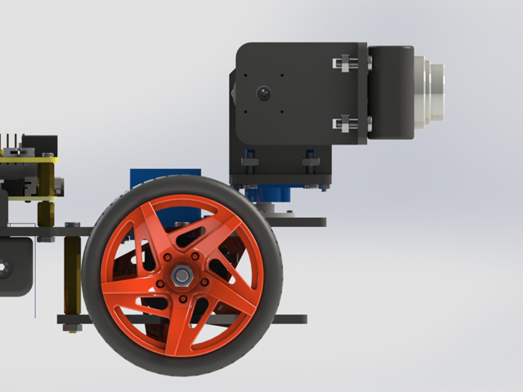
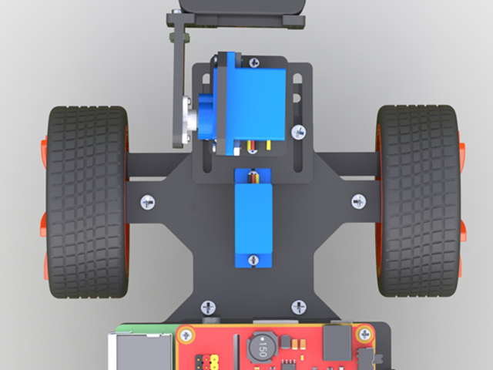
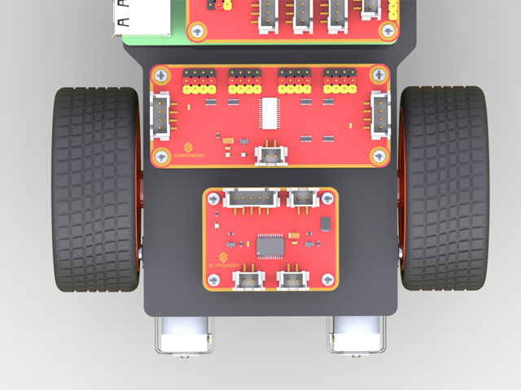
HW
PIC Car V2 was selected as best platform to run the path.
Capabilities:
Rasp v3 + Power & Motor HATS
IO & power extension board
Mechanical build + case
Battery/ external DC support
Front wheel servo (+-35 deg)
On board 2 axis servo based camera
Rear wheel 2 motors + gearbox

Slide 5
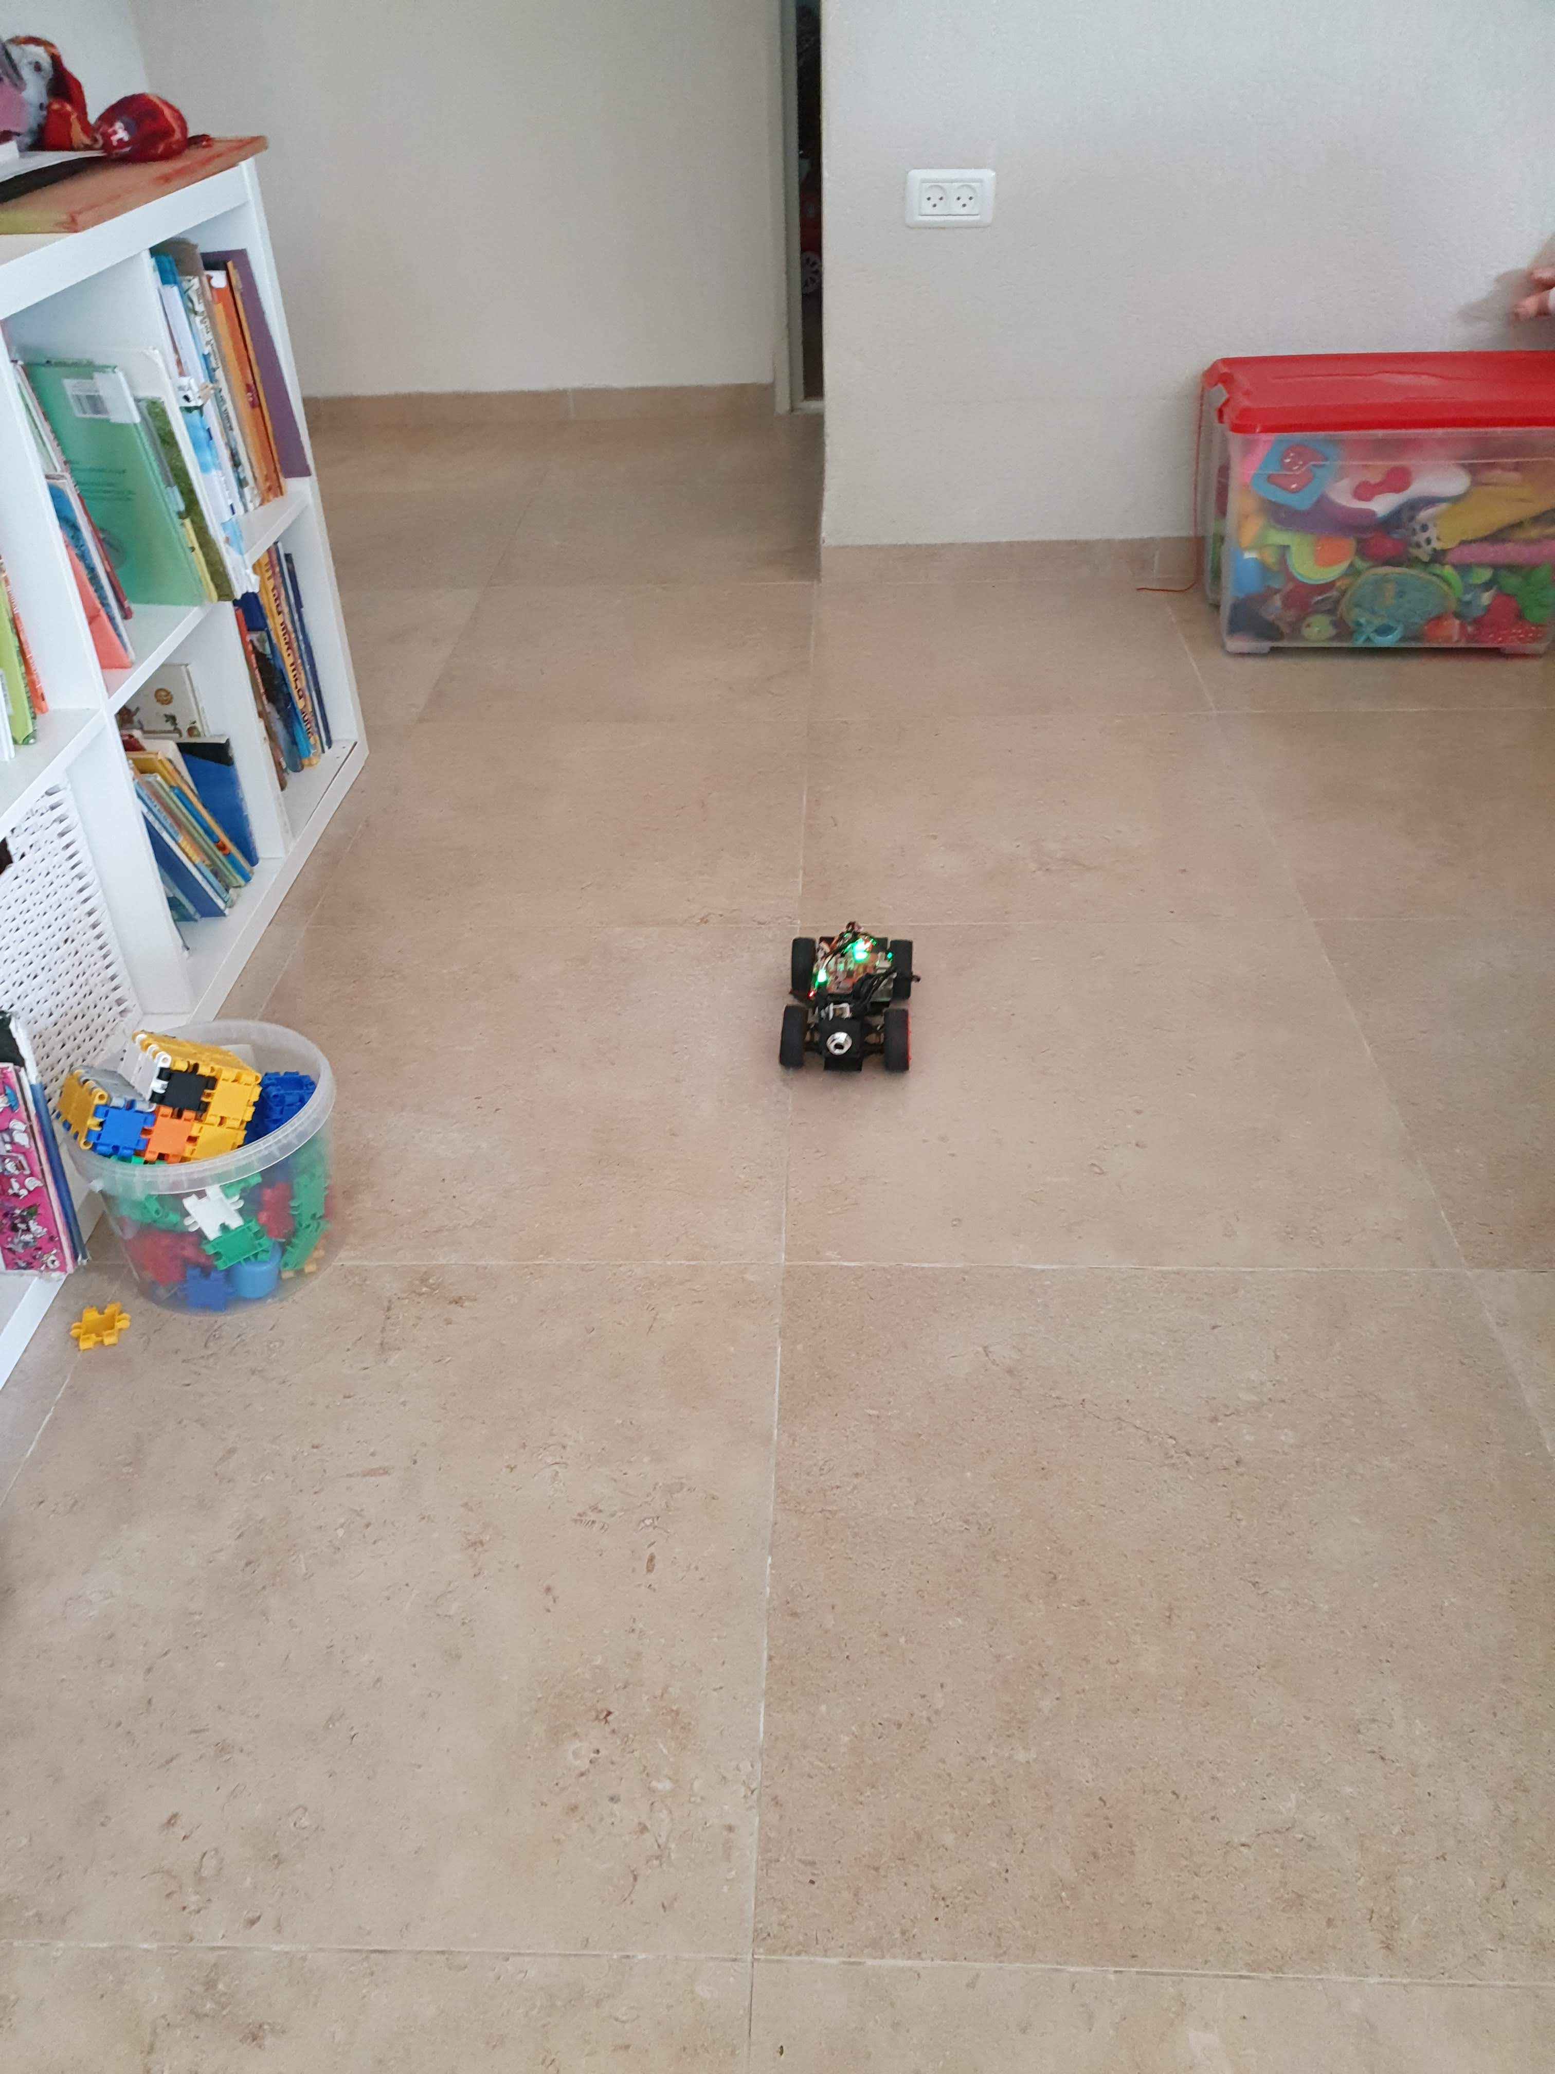
Mechanical & Car Frame
Building the car was quite fun and amusing
Mechanical parts seemed to fit well and as mentioned
Car calibration was not an easy task at first but after some investigation and reassembly of the wheels to fit better, was resolved.

Slide 6
OS
Tested Env:
Windows 10 IOT core
Was found easy to maintain and able to install dev IDE + remote quite easily
Performance was highly degraded
Fast bootup
Power consumption efficient (not tested)
Missing servo drivers convinced to switch to ubuntu
Ubuntu - Ubuntu 18.04.4 LTS
Was found easy to maintain and able to install dev IDE + remote quite easily
relatively Fast bootup
Internal support in both servo and motor boards
Car vendor support python libraries

Slide 7
Dev Env & Technology
After selecting Ubuntu as OS, several options examined to run the Algorithm:
Direct MATLAB interfacing with Raspberry
Seemed the ideal solution at first
Wizard based installation directly to RASP 3 capabilities
Troubleshooting –
Servo motors and motor board did not behave as expected while transferring commands from MATLAB (Burnet front wheel servo ☹ while trying to reach edge limit)
C++ code compilation to external code run by the car
Tested for a feasibility – and seemed to work well
The problem – the code was a mess , extremely hard to understand and integrate.
Optional solution- create a lib based code (black box) to integrate in the car – not tested.
HTTP Communication
Relatively easy implementation
Easy to debug and modify as needed
Problem – HTTP has enormous lag and does not guarantee timing constraints
Solution – transfer all commands to an internal Queue and play the commands internally in the car to achieve (relative) time accuracy of commands duration.

Slide 8
Open issues
Fitting the car dimensions into the alg. Was quite problematic for some reasons –
Small axle distance (14cm) caused the DDP alg. To not converge to a solution (alg. inputs computed as Meters, M/s, M/s^2)
Car acceleration is quite low (measured 0.2m/s^2) also causing the algorithm strange and unreliable outputs.
Fixed horizon parameter – prolonging the path of the car while not being able to converge in some parameter combinations (circular endless route not reaching the goal)
No digital Encoder to servos – Meaning command is running in an open loop with no control feedback whatsoever to maintain servo angle
I’ve struggled quite a lot with this issue at first while trying to drive straight path at testing phase and understood that this is a HW constraint in this platform which will limit the option for accuracy. (although as I read and understand - can be fixed by camera image stabilization algorithm)

Slide 9
Conclusions
This lab course was extremely fun to work on, I’ve really enjoyed it.
I was quite disappointed to find out that fitting the model into the real-life RC car did not work as expected (although the route itself is performing correctly in general but not in exact Meter units as I’ve tried to fit)
This platform is highly extensible, reusable if needed, and scalable to any alg. Wish to run on this Car as it is now (Simple HTTP interface), and can also run on the car itself as a python/CPP code with a network socket.
Thanks you for the project, and the chance to explore these new areas and Technologies.

Slide 10
Links & Ref.
Git Project Page:
https://github.com/michaaga/PyCarTrajProject
Sunfounder RC Kit –
https://www.sunfounder.com/smart-video-car-kit-v2-0.html
Raspberry Ubuntu –
https://ubuntu.com/download/raspberry-pi
Win 10 IOT Core –
https://docs.microsoft.com/en-us/windows/iot-core/tutorials/rpi
Control-Limited Differential Dynamic Programming
https://homes.cs.washington.edu/~todorov/papers/TassaICRA14.pdf

